Slide 1
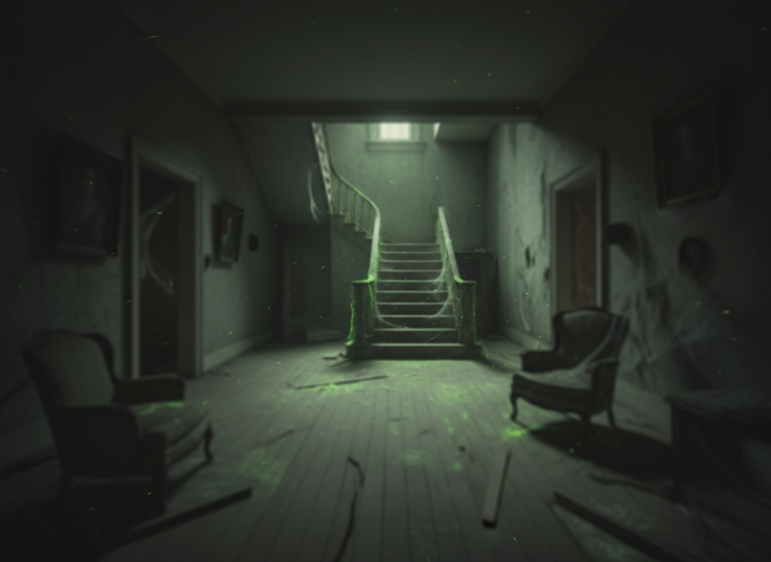
CSC 102 Diffuse The Bomb Project
Viviane Gunthel, Jack Ballard, Jaeden Pouchie

Slide 2
Overview
Haunted House themed bomb with 4 custom phases
Wordle – Keypad
Wires Phase – Wires and Keypad
Ritual Phase – Button and Toggles
Quiz Phase – Toggles and Keypad
Timer Bonuses and Penalties
Custom Scary GUI with hidden jumpscare penalties

Slide 3
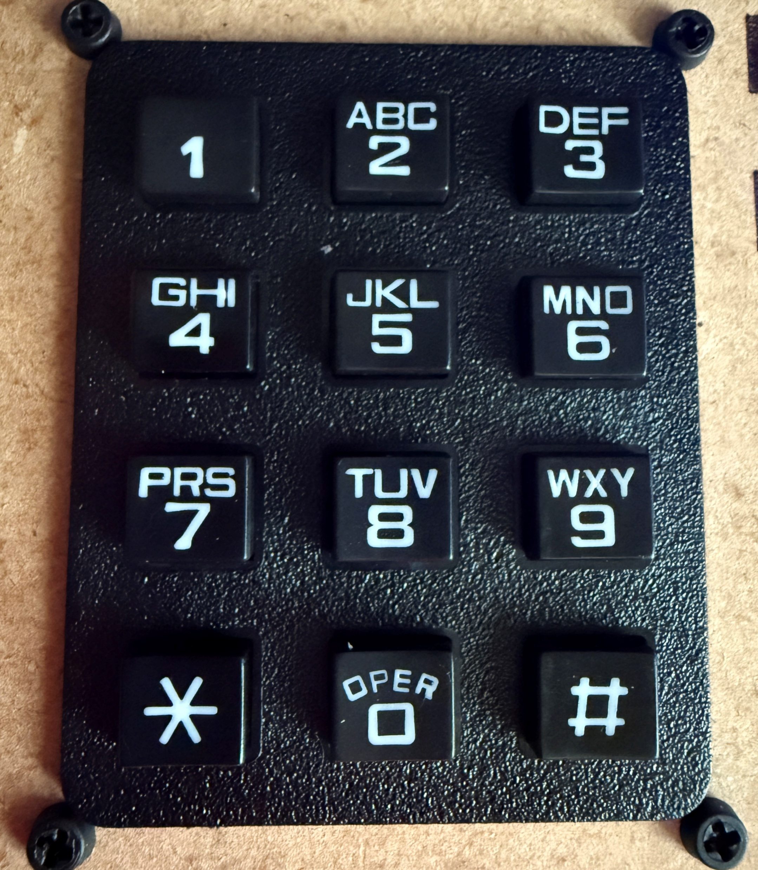
Unique Implementations
Wordle T-9 Keypad
Each key stores multiple letters
Allows the user to cycle through letters
“1” confirms a letter
“#” submits a guess
“*” backspace

Slide 4
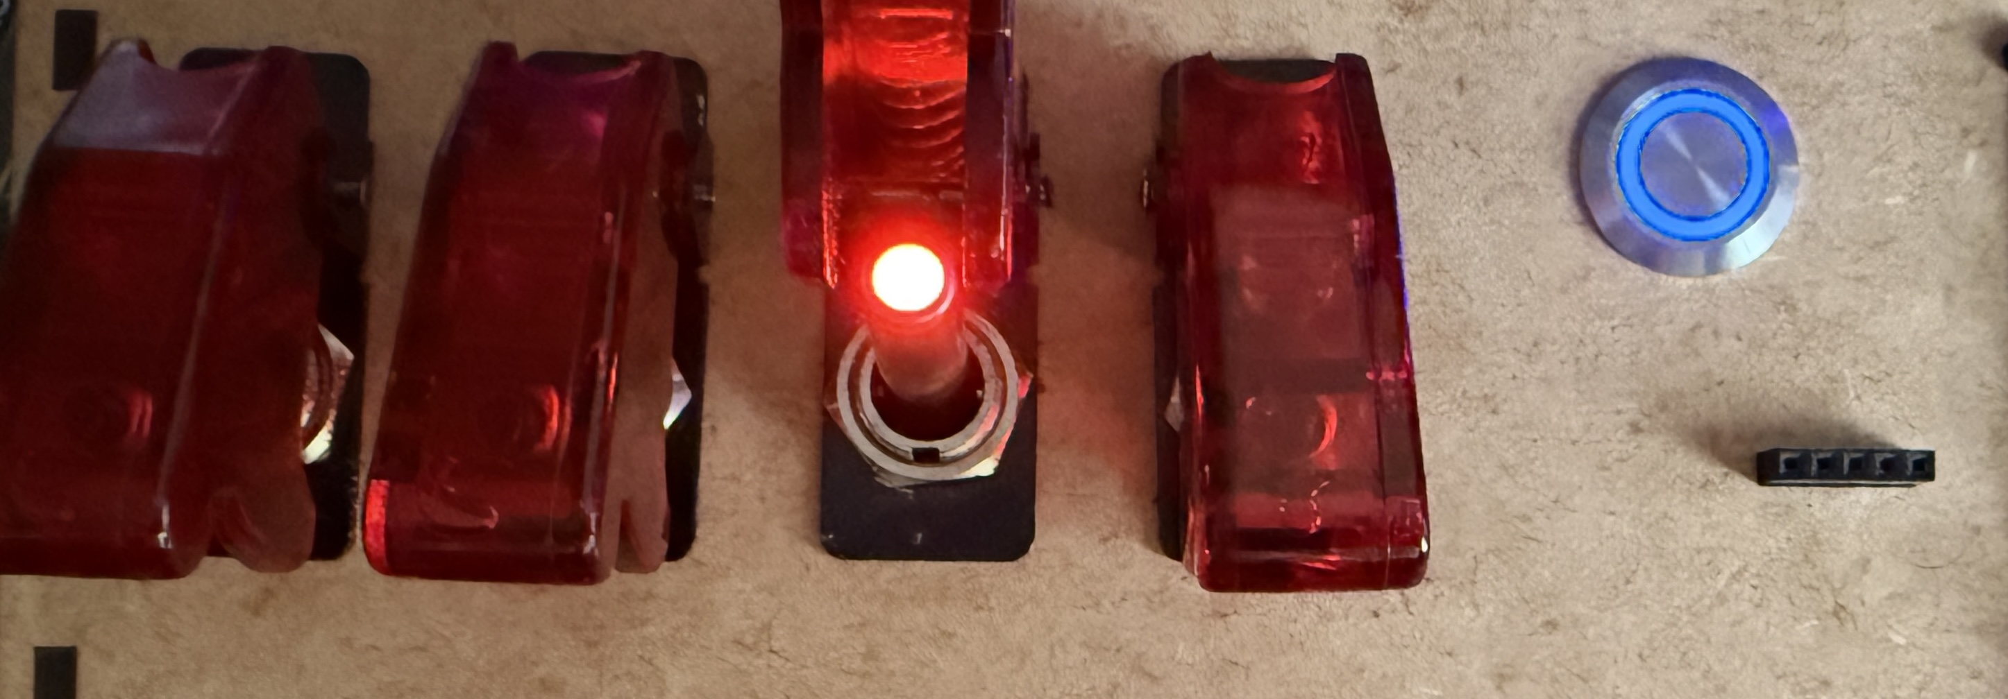
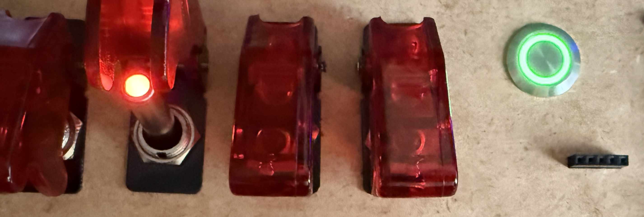
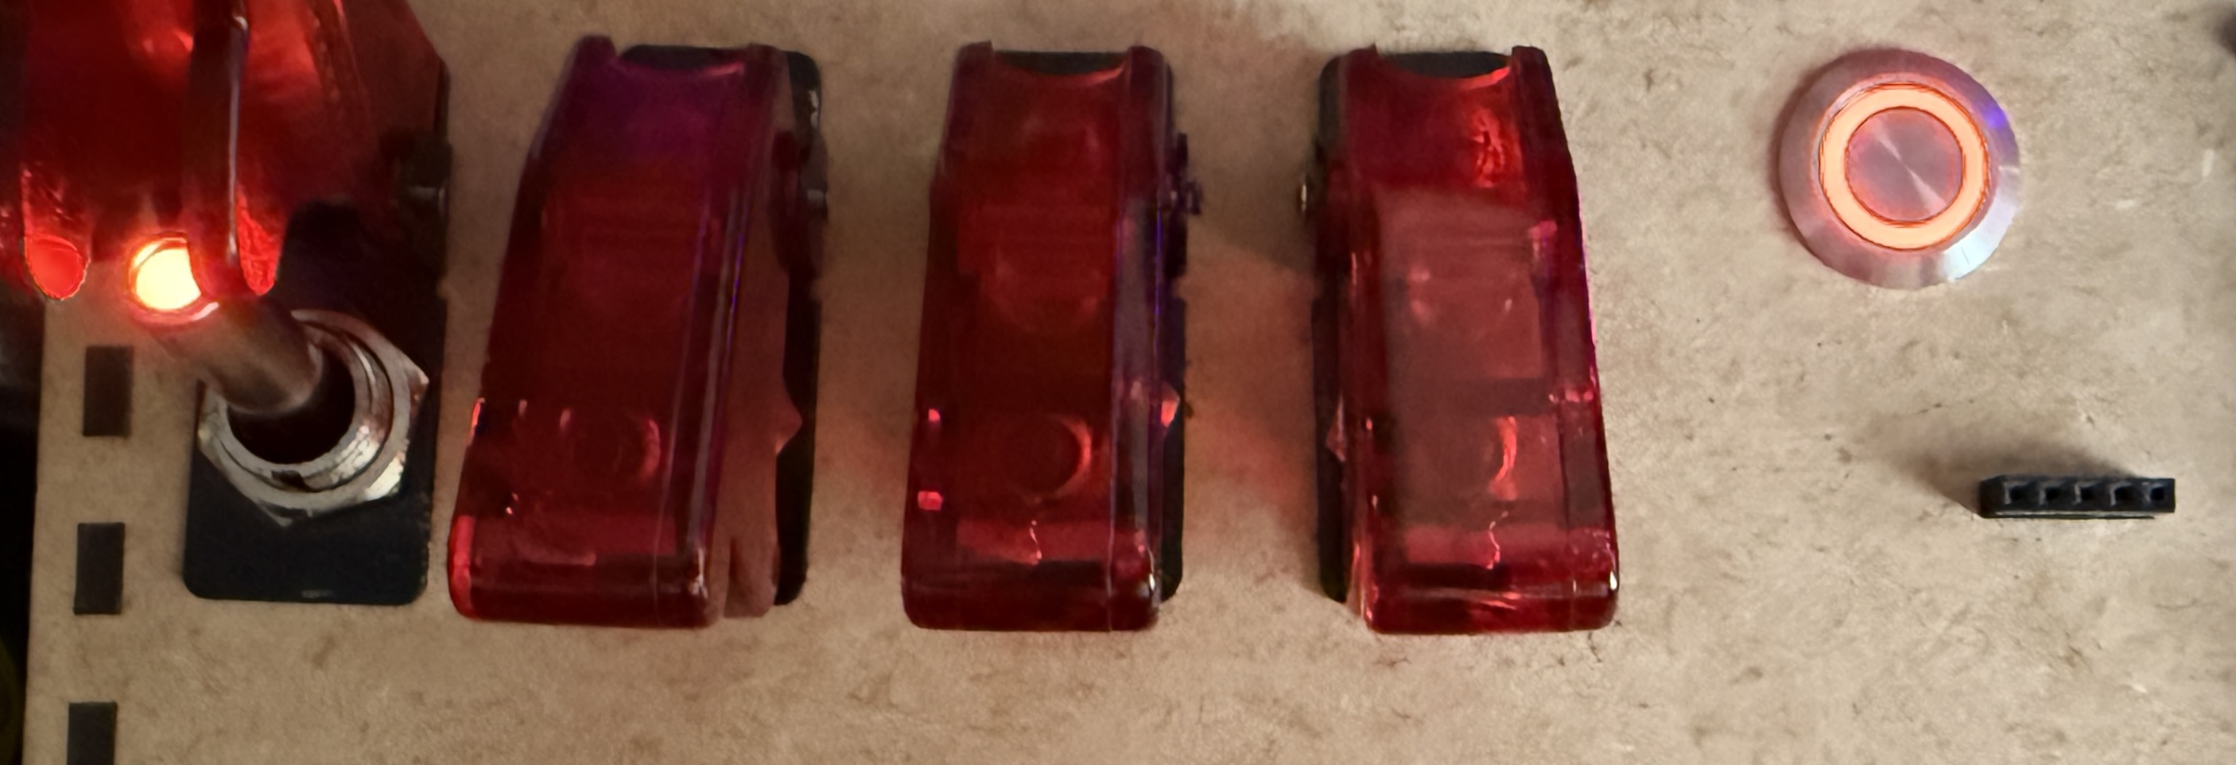
Unique Implementations
Ritual Phase Toggle Color Selection
Each toggle is mapped to a specific color (1000 = Red, 0100 = Green, 0010 = Blue)
One toggle is set aside for resetting the sequence in case of a mistaken input
Clicking the button locks in the selected color for the sequence
Quiz Toggle Answer Selection
Each toggle maps to an answer in the Quiz Phase (A = 1000,B = 0100 ,C = 0010, D = 0001)

Slide 5
Future Implementations
Haptic Feedback
Vibrations or clicks when a step is completed incorrectly
More procedural generation of puzzles
Adding more variation in our code so that no puzzle is ever the exact same.
Leaderboards
A leaderboard at the end showing the fastest defusal times
Co-op mode
Split-screen mode to complete puzzles in tandem

Slide 6
How this project benefited us
Technical growth
Python programming, Tkinter, GUIs
Problem Solving Skills
Decomposition, and collaboration
Creative Skills
Developed unique ideas for puzzles and sequences

Slide 7

Demonstration

